Slide 1
Slides
Title [30s]
Outline [30s]
Problem (i.e. Problem + Why) [1 min]
Solution thoughts (i.e., Success + Audience) [1 min]
Data + Model (i.e., What, 1st part) [1 min]
Demo [2 min]
MLE Stack/Iterations (What, 2nd part) [2 min]
Conclusions (and lessons learned) [90s]
Future Work [30s]
(Thank You & Q&A) [0s]

Slide 2

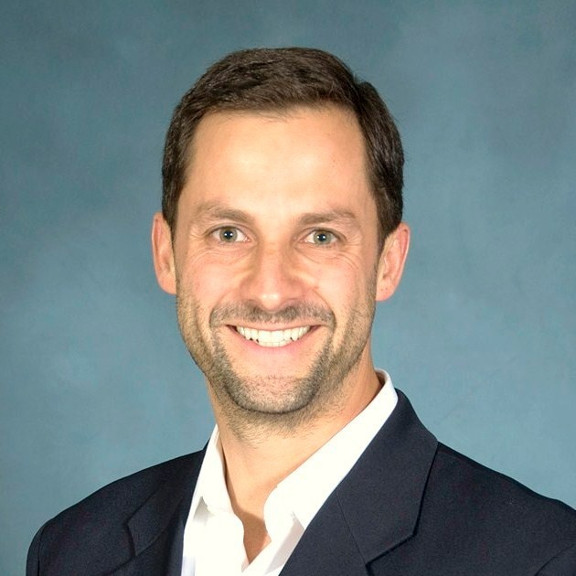

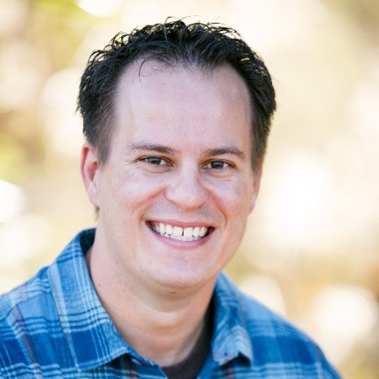
Project A match made in machine learning heaven: linking every client request to the best expert Cris Fortes, Ying Hu, Cody McCormack
Notes:
This is the slide where you actually SAY your 1-2 sentence elevator pitch. Engage your audience!!

Slide 3
Outline
Problem
Solution
Data + Model
Demo
MLE Stack
Conclusions (and lessons learned)
Future Work

Slide 4
Problem (1 min)
GLG's business largely revolves around matching clients, requesting insights on a specific topic, with an expert on that topic from their large database so that they can meet by phone, video or in person. Visually:
Input
Our focus
Client needs insights on a specific topic
Client submits a written request to GLG for access to an expert on that specific topic
Matched client and topic expert meet by phone, video or in person
GLG seeks and matches the best expert for each specific request
GLG has 1 million freelance experts on their database
Since GLG receives 100s of these requests per day, how can they leverage machine learning to semi-automate the matching process at scale?
Notes:
Specify what Problem is being solved, and ensure that everyone is in agreement as to Why that’s a problem.
Tell me about the problem you’re trying to solve.
Imagine me shaking my head in agreement that this IS, in fact, a problem.
Keep telling me Why it’s a problem until I shake my head up and down.
Is the business value hypothesis clear to me yet?
If so, move on. If not, retry
Also, NEVER more than 6 bullets on a slide!!!

Slide 5
Solution (1 min), preliminary
Natural Language Processing (NLP)
1
2
Named-Entity Recognition (NER)
Selected libraries: spaCy, The Natural Language Toolkit (NLTK)
Clustering
Topic modeling: latent Dirichlet allocation or LDA (being tested, promising)
K-means clustering (current results disappointing; to be tested using better embedding algorithm)
3*
* Step 3 would be to build a recommendation system to suggest the highest matching expert(s) for each request but that is outside the scope of this project
Notes:
Specify what Success looks like, and for what Audience.
Wouldn’t it be great if a user with this problem had a solution like this!?.
Paint the picture of that future world where the problem is solved.
Objectively, what would that be like for them? Better, faster, cheaper?
How do we get there? What would we measure to know if we got there?
Five bullets are always better than 6.

Slide 6
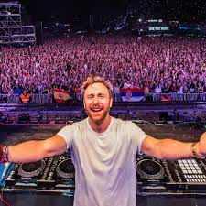
Solution (1 min), preliminary
Illustrative and simplified example:
1
2
3*
Input
Model
Output
Model
Output
Model
"I need to know what David Guetta is up to these days including what he may do next."
NLP
NER
"I need to know what [David Guetta]_{Person} is up to these days including what he may do next."
C
LDA
Possible Topic 1: DJ, dance music (98%); Possible Topic 2: French (90%); Possible Topic 3: Ibiza (60%);
↑
[David Guetta]_{Person}
GLG seeks experts in their database based on the topic categorized by the model
David Guetta
Acronyms: NLP (Natural Language Processing), NER (Named-Entity Recognition), C (Clustering), LDA (latent Dirichlet allocation), DJ (Disc Jockey), GLG (Gerson Lehrman Group). * Step 3 is outside the scope of this project
Notes:
Specify what Success looks like, and for what Audience.
Wouldn’t it be great if a user with this problem had a solution like this!?.
Paint the picture of that future world where the problem is solved.
Objectively, what would that be like for them? Better, faster, cheaper?
How do we get there? What would we measure to know if we got there?
Five bullets are always better than 6.

Slide 7
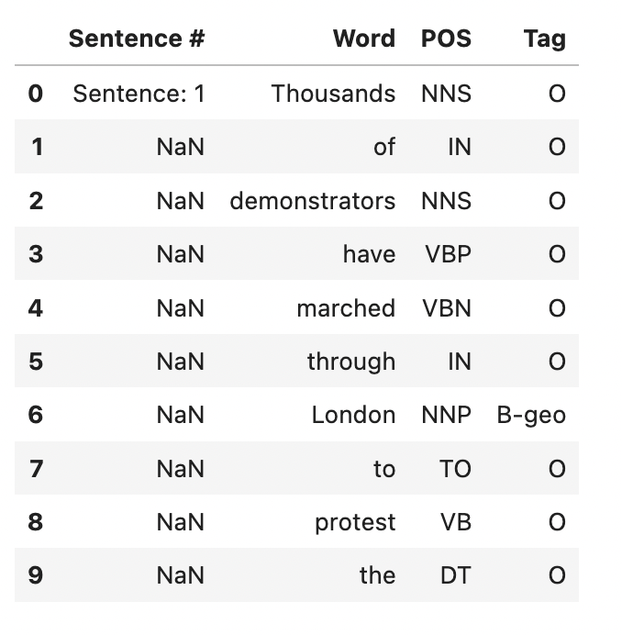
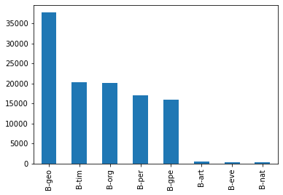
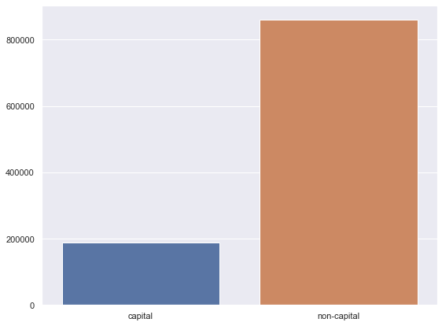
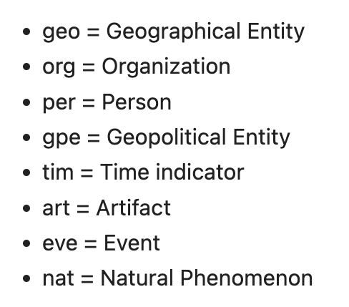
Data (1 min)
Did exploratory data analysis (EDA) on two datasets from Kaggle:
Annotated Corpus for Named Entity Recognition | Kaggle
Next step: train our model using this other 2.7-million news articles dataset:
All the News 2.0 - Components
List of entity tags
Example of entity tag
Plot of entity tag count
Capital vs. non-capital word count
Notes:
Any unique data wrangling/data-centric AI? If not, leave out. Lineage?
Pre-trained model? If not, why not? Fine-tuned? If not, why not?
Messy live data, modeling explainability aspects, ethical/responsible?
Choose wisely; time is of the essence; four bullets always better than five.

Slide 8
Model status: accomplishments, challenges (1 of 2)
1
Named-Entity Recognition (NER)
Test 1, using spaCY predictions:
Accuracy: 0.937, Recall: 0.619, Precision: 0.753, F1 Score: 0.680
Test 2, TPOT for AutoML: too computationally intense for local machine
Test 3, using one-hot encoding:
XGB: Accuracy: 0.959, Recall: 0.906, Precision: 0.755, F1 Score: 0.824
Logistic Regression: Accuracy: 0.932, Recall: 0.761, Precision: 0.659, F1 Score: 0.706
Test 4, using TF-IDF encoding:
XGB: Accuracy: 0.935, Recall: 0.881, Precision: 0.644, F1 Score: 0.744
Logistic Regression: Accuracy: 0.921, Recall: 0.612, Precision: 0.638, F1 Score: 0.625
Test 5, using one-hot encoding with preprocessed data:
XGB: Accuracy: 0.959, Recall: 0.906, Precision: 0.758, F1 Score: 0.825
Logistic Regression: Accuracy: 0.932, Recall: 0.761, Precision: 0.659, F1 Score: 0.706
Test 6, using TF-IDF encoding with preprocessed data:
XGB: Accuracy: 0.935, Recall: 0.881, Precision: 0.644, F1 Score: 0.744
Logistic Regression: Accuracy: 0.921, Recall: 0.612, Precision: 0.638, F1 Score: 0.625
Notes:
Specify what Success looks like, and for what Audience.
Wouldn’t it be great if a user with this problem had a solution like this!?.
Paint the picture of that future world where the problem is solved.
Objectively, what would that be like for them? Better, faster, cheaper?
How do we get there? What would we measure to know if we got there?
Five bullets are always better than 6.

Slide 9
Model status: accomplishments, challenges (2 of 2)
2
Clustering
Model 1: Bag of words + KMeans
n_cluster=2: Silhouette Coefficient is 0.28 for random_states=1, 5, 10, 42
n_cluster=3, Silhouette Coefficient is 0.17 for random_states=0, 1
Silhouette Coefficient decreases as n_cluster increases.
Model 2: TF-IDF + KMeans
n_cluster=2: Silhouette Coefficient is 0.00814
n_cluster=3: Silhouette Coefficient is 0.000157
Model 3: Bag of words + PCA + KMeans
n_cluster=2: Silhouette Coefficient is 0.28
n_cluster=3, Silhouette Coefficient is 0.17
Model 4: Bag of words + PCA + Agglomerative
Aborted: It took too long to run; after 50 mins, the model is still running.
The code is tested on a small portion of the dataset.
Model 5: Bag of words + LDA (to be tested further)
So far, with topic number = 10, the model seemingly outputs the most sensible list of topics.
See questions at later slide about 1) whether to use much bigger dataset and 2) how best to connect NER output to clustering model…
Notes:
Specify what Success looks like, and for what Audience.
Wouldn’t it be great if a user with this problem had a solution like this!?.
Paint the picture of that future world where the problem is solved.
Objectively, what would that be like for them? Better, faster, cheaper?
How do we get there? What would we measure to know if we got there?
Five bullets are always better than 6.

Slide 10
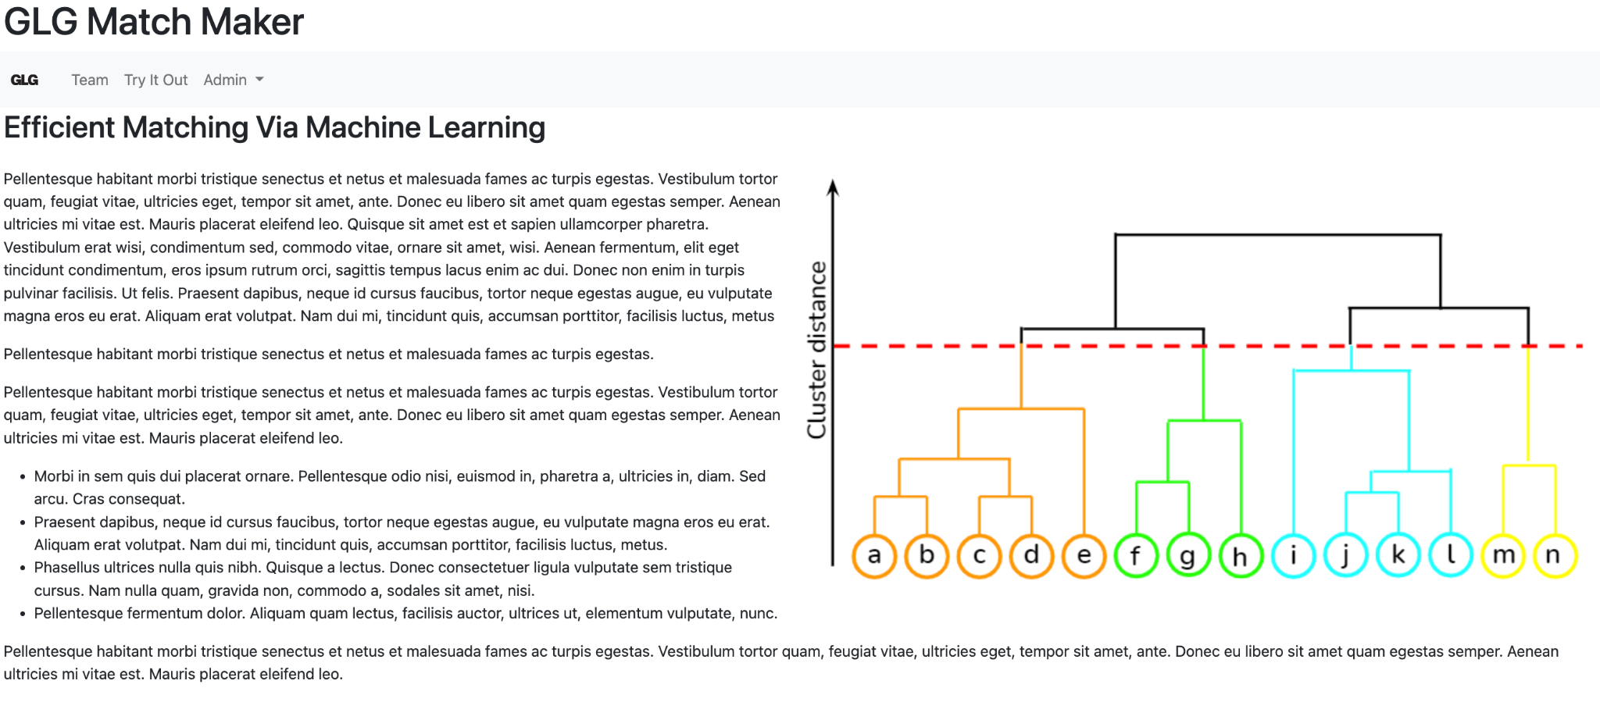
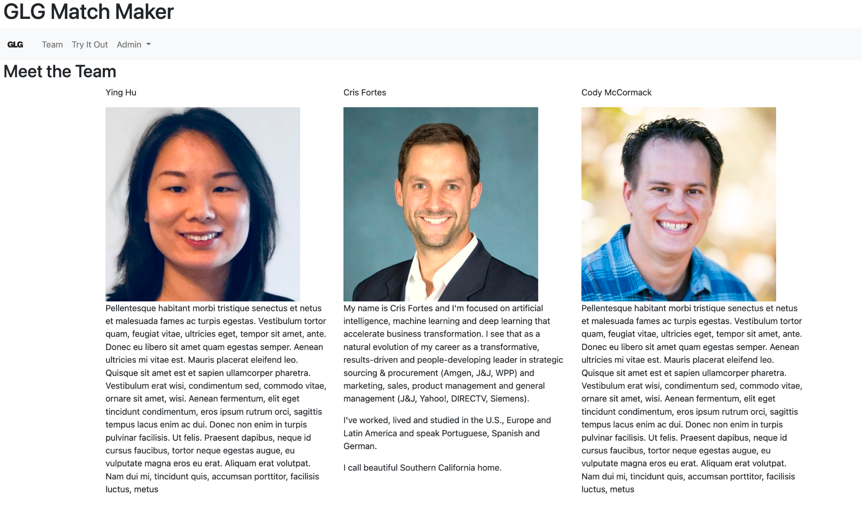
Next steps: starting to develop a web app in Flask
Deployment (work in progress)
Notes:
Specify what Success looks like, and for what Audience.
Wouldn’t it be great if a user with this problem had a solution like this!?.
Paint the picture of that future world where the problem is solved.
Objectively, what would that be like for them? Better, faster, cheaper?
How do we get there? What would we measure to know if we got there?
Five bullets are always better than 6.

Slide 11
Questions:
Data issue:
We don’t have GLG's "client request" (input) dataset to test our model.
Looking at the clustering results, there is a concern that the dataset we are using may not be diverse enough in terms of the topics it involves.
Should we use the bigger News 2.0* dataset?
if so, do we need to run it on AWS?
Connections between two parts of the model:
How can we use the tagged words from the NER model in the second clustering part? At the moment, the clustering is done using the entire sentence, with stopwords and punctuation removed.
Some sentences don’t have tagged words.
* All the News 2.0 - Components: 2.7-million news articles dataset

Slide 12
Data (1 min)
Did exploratory data analysis (EDA) on two datasets from Kaggle:
Annotated Corpus for Named Entity Recognition | Kaggle
Next step: train our model using this other 2.7-million news articles dataset:
All the News 2.0 - Components
List of entity tags
Example of entity tag
Plot of entity tag count
Capital vs. non-capital word count
For discussion: use this data to train the model (in light of capstone time constraints?)
Notes:
Any unique data wrangling/data-centric AI? If not, leave out. Lineage?
Pre-trained model? If not, why not? Fine-tuned? If not, why not?
Messy live data, modeling explainability aspects, ethical/responsible?
Choose wisely; time is of the essence; four bullets always better than five.

Slide 13
Q&A and Feedback
Project A match made in machine learning heaven: linking every request to the best expert Cris Fortes, Ying Hu, Cody McCormack

Slide 14
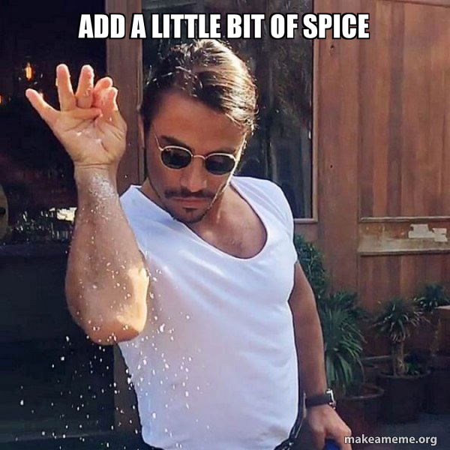
Demo (2 min)
… & screen share well!

Slide 15
MLE Stack (2 min)
Exploratory Data Analysis & Wrangling
Experimentation
Data Engineering Pipeline
Machine Learning Pipeline
Deployment Pipeline
These ^^ are probably worth talking about
Maybe consider…
Feature Store
Metadata store
Model registry
Model serving
Model Monitoring
Add your stack image here!

Slide 16
Conclusions (90 s)
We learned to do end-to-end ML the easy way, the hard way
Let us tell you about it!
Here’s a tip or two for anyone who tries to walk down a similar path!
And the biggest lesson we’re taking with us into the future is …
Notes:
This is where you can tell funny stories about the stupid things you did!
This is also the slide where you might convey the difference between what you set out out to do, and what you actually did.

Slide 17
Future Work (30 s)
Given those conclusions and lessons…
here’s what we would do next…
in rank order…
and here’s why
That’s a wrap!

Slide 18
Thank You! Questions?
Project A match made in machine learning heaven: linking every request to the best expert Cris Fortes, Ying Hu, Cody McCormack

